Slide 1
Non-Verbal Communication
Chapter 6
University of Colorado Denver

Slide 2
Importance of Non-Verbal Comm
Nonverbal accounts for 65%-93% of the total meaning of communication (Birdwhistell, 1970; Mehrabian, 1981).
  What we do often conveys more meaning than what we say
    Mixed messages: we believe the nonverbal more

Slide 3
Functions of Nonverbal Communication
        Communicate information
        Regulate interactions
        Confessing emotion
        Presenting the self/managing impressions
        Express and manage intimacy
        Defining, creating, and maintaining relationships
              Intimacy, dominance, submissiveness, dismissiveness

Slide 4
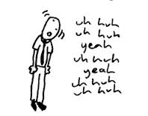
Types of Nonverbal Comm.
Body movement – kinesics
  Face & eyes
  Posture
  Gestures – fidgeting
Voice – paralanguage
  Vocal rate, pronunciation, pitch, tone, volume, emphasis, rhythm, range
  Unintentional pause, vocalized pause
  Sarcasm
Silence
Notes:
Haptics: Can be professional, functional, social-polite, friendship, love-intimate, aggressive or demand
Paralanguage: its not what you said, its how you said it

Slide 5
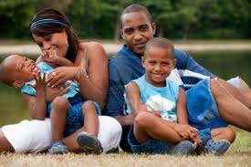

Types on Nonverbal
Touch – haptics
Time – chronemics
Physical attractiveness
Clothing
Physical environment and artifacts
  Homes, furniture, offices
Notes:
Being touched less often, less affectionately – what does it communicate?
Someone oversleeping and showing up late for a job interview – what does it communicate about one’s work ethic

Slide 6
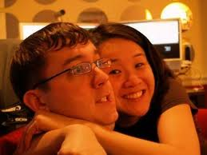
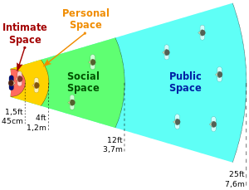
Types on Nonverbal
Distance – proxemics
  Personal space varies culturally
  Territoriality
  Barrier behaviors
    Back away, put object between you, decrease eye contact, leave or counterattack
Notes:
Refusing to sit next to someone when you are angry
May communicate intimacy or power

Slide 7
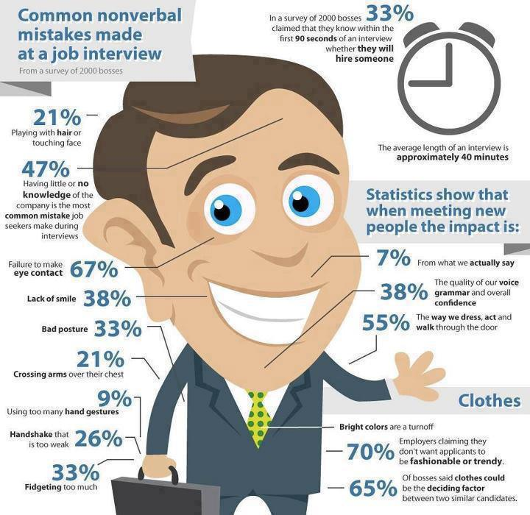

Slide 8
Managing Your Nonverbal Communication Ethically
Remember that people trust your nonverbal over your verbal
Adapt your nonverbal communication according to each context, interaction
Reflect your real attitudes, beliefs, and feelings
Do not contradict the verbal message you are sending
Do not insult, ridicule, or demean others nonverbally

Slide 9
Managing Your Nonverbal Communication Ethically
  Recognize that the meanings for nonverbal behavior vary with individual, contextual, and cultural factors
  Examine how congruent or in harmony it is with the verbal messages you receive.
  Ask for additional information if you are unsure of the meaning of nonverbal communication
  Remember that not all nonverbal behavior is intentionally communicative

